Slide 1
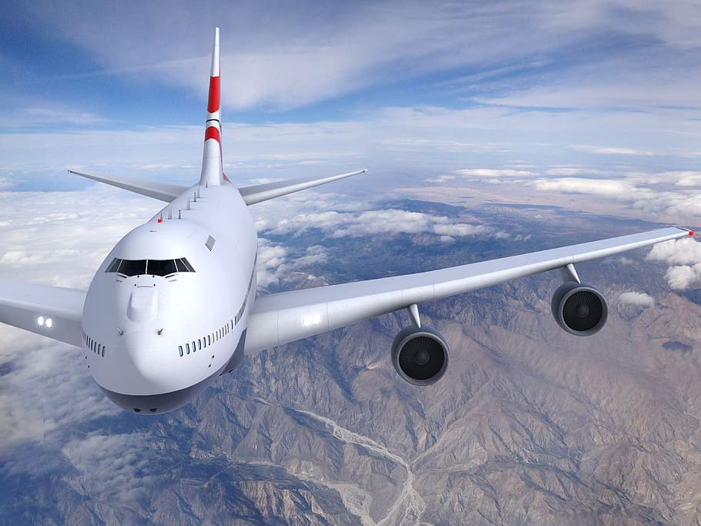
AIR-TICKET RESERVATION
GROUP-C
Harsit Kumar
Nisarga gowda
Parinitha Shkar
Shivprasad Shetty

Slide 2

ABSTRACT
Airline reservation System is a computerized system used to store and retrieve
information and conduct transactions related to air travel.
This software has two parts. First is user part and the administrator part. User
part is used as a front end and administrator is the back end.
The main purpose of this software is to reduce the manual errors involved in the
airline reservation process and make it convenient for the customers to book the flight.

Slide 3
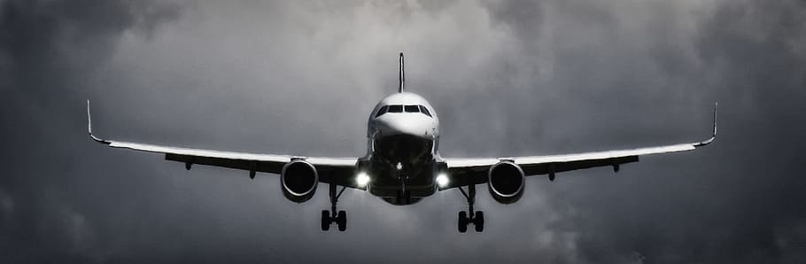
INTRODUCTION
The project aims to design an Airline Reservation System application which enables the customers to search and book flight .
Airline Reservations Systems contain fare tariffs, passenger reservations and ticket records.

Slide 4
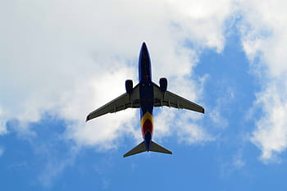
PROBLEM STATEMENT
The main objective of the Online Air-Ticket Reservation System is to manage the details of Flights, Registrations, and Booking the Flights.
Online Air-Ticket Reservation system is a friendly format for Booking and viewing the available flights . Users can search and browse for flights in this application.
This application mainly concentrates on maintaining and managing the details of the Flight booking.
This System provides a superior experience by making it easier, faster, secure and more accurate to find flights and book them.

Slide 5
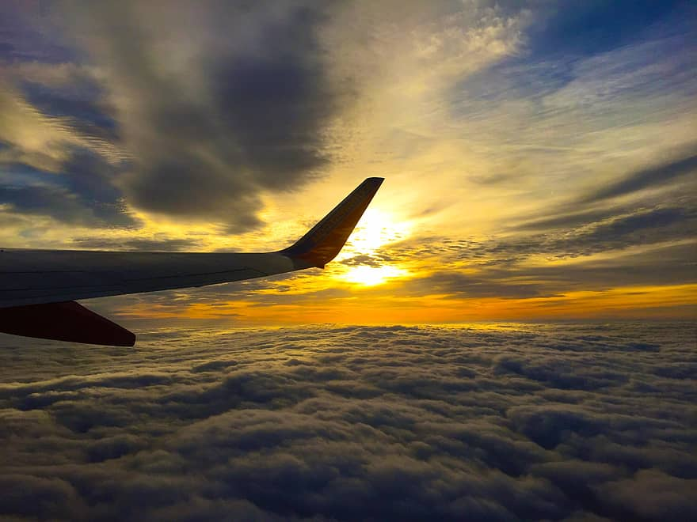
BUSINESS REQUIREMENTS
The application have the login and register option for admin and user.
To manage the details of flights, admin page, and user registrations.
To allow users to search flights and to book flights.
Allows the admin to edit the flights , Active or inactive the Flights.

Slide 6
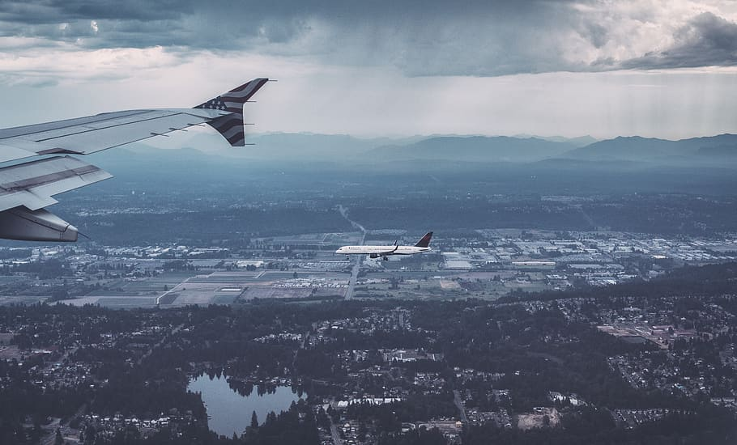
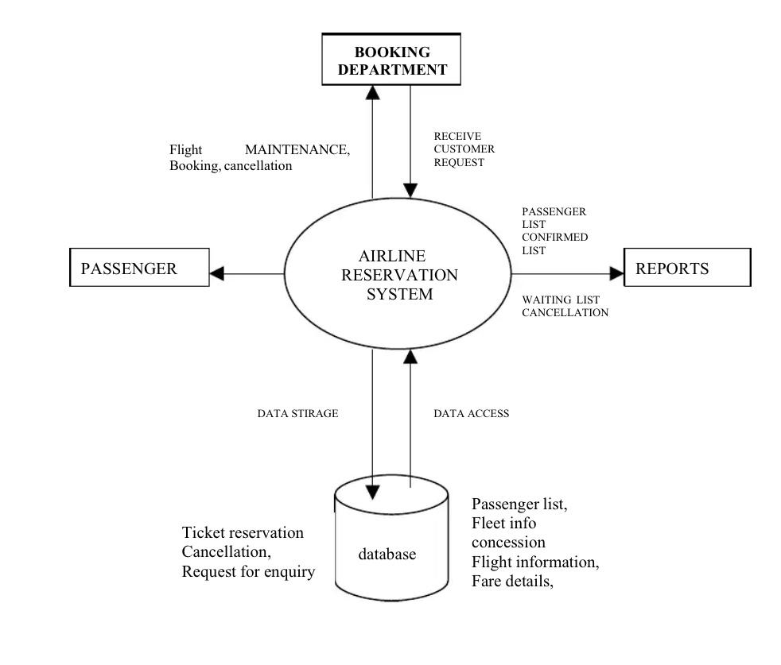
DESIGN OF AIR RESERVATION

Slide 7
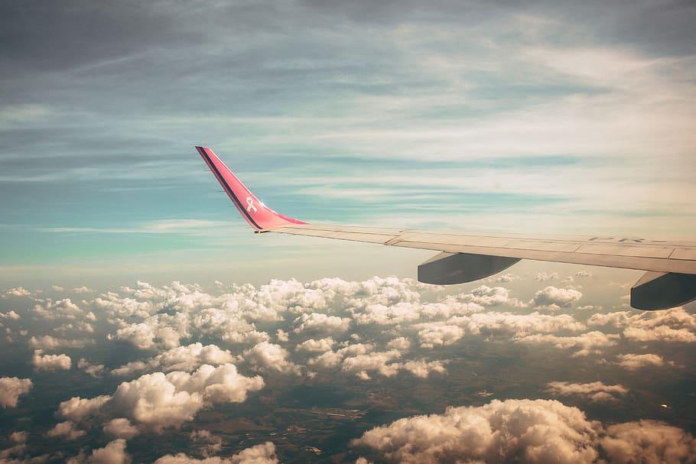
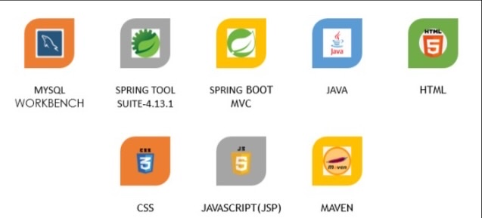
TOOLS AND TECHNOLOGIES

Slide 8
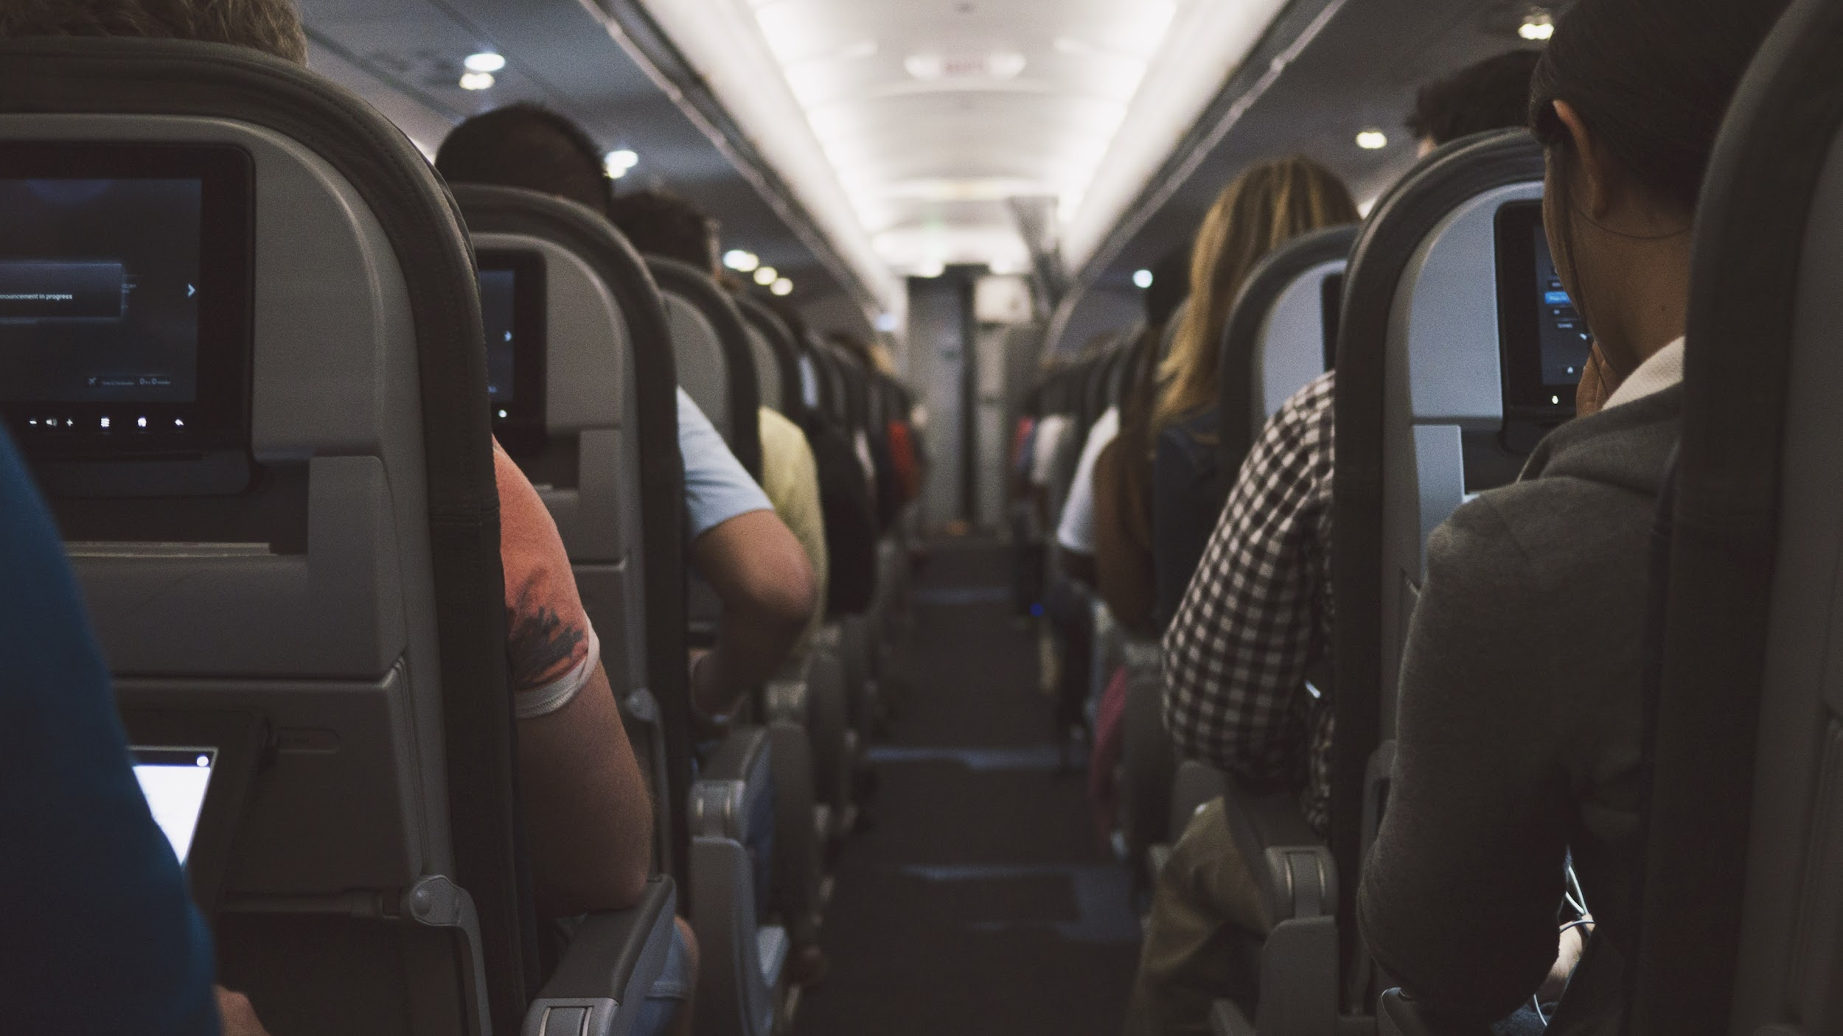
CONCLUSION
The main objective of the Online Air-Ticket Reservation System is to manage the details of Flights, Registrations, and Booking the Flights.
Online Air-Ticket Reservation system is a friendly format for Booking and viewing the available flights . Users can search and browse for flights in this application.
This application mainly concentrates on maintaining and managing the details of the Flight booking.
This System provides a superior experience by making it easier, faster, secure and more accurate to find flights and book them.

Slide 9
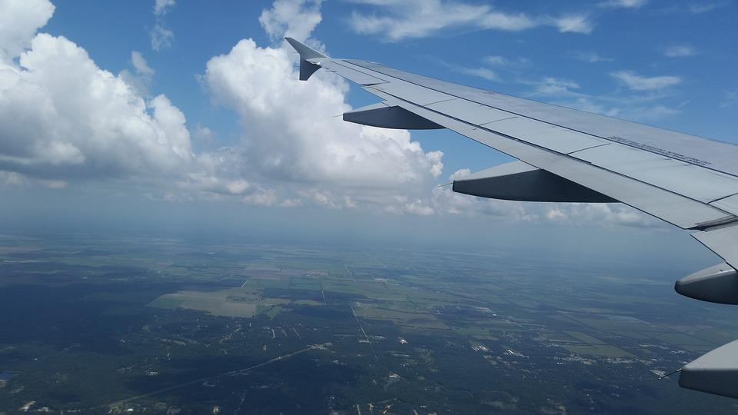
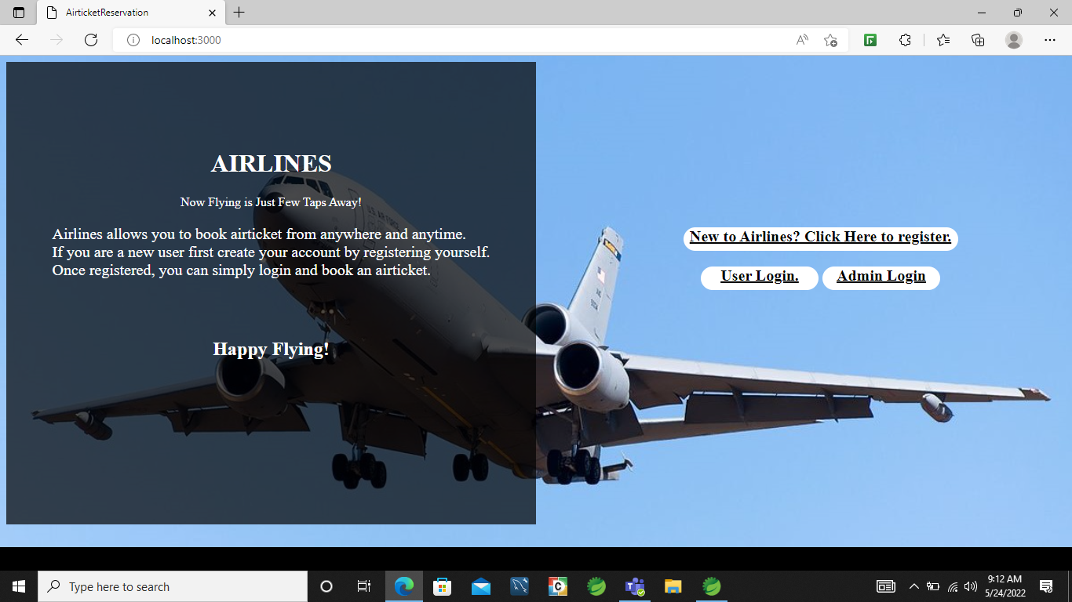
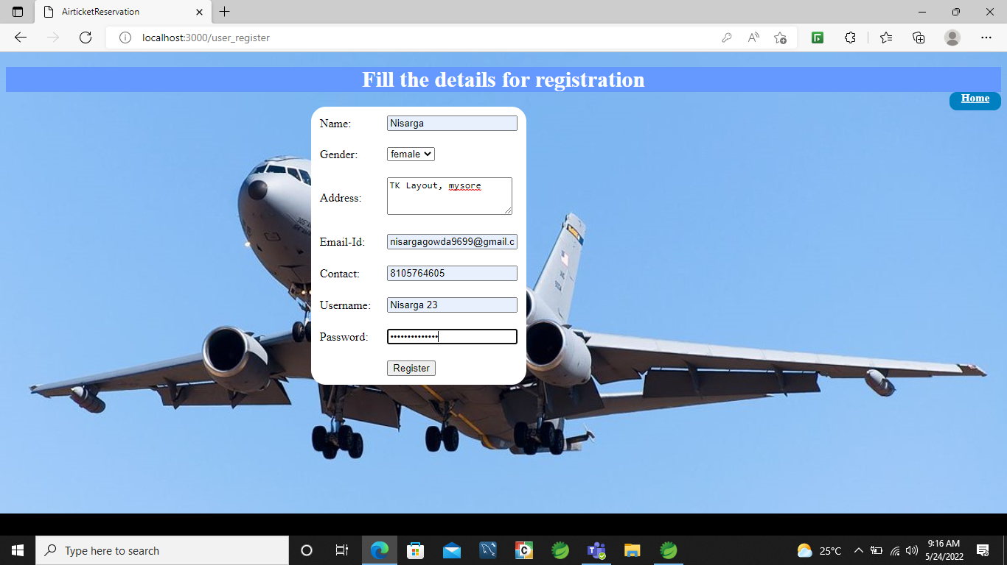
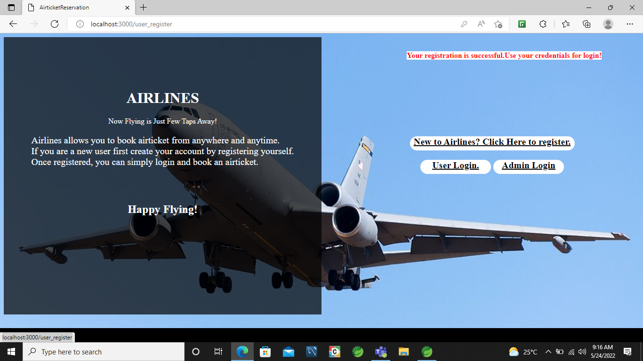
HOME PAGE

Slide 10
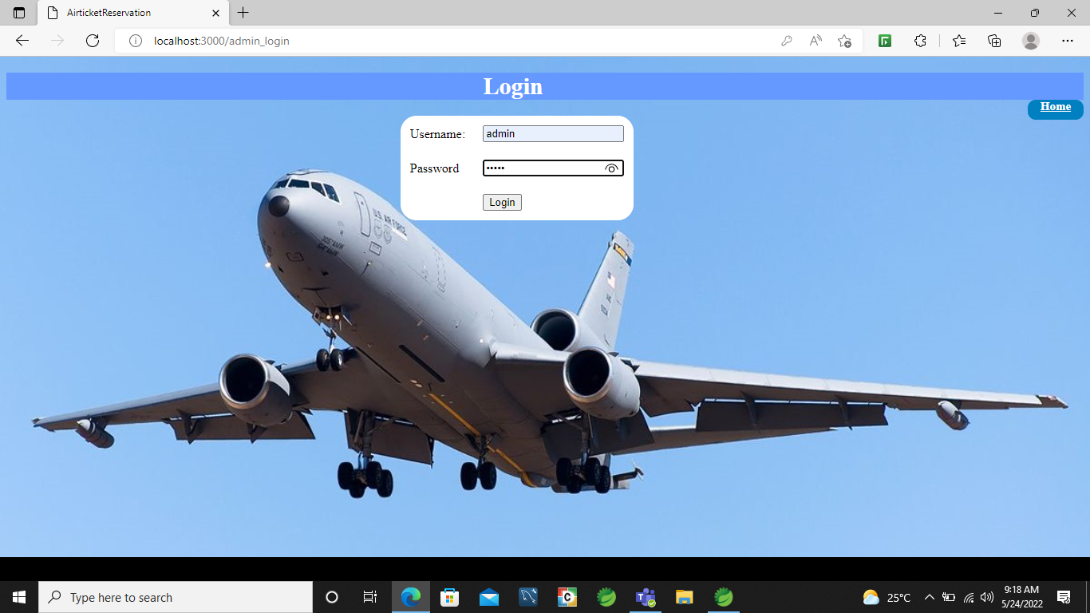
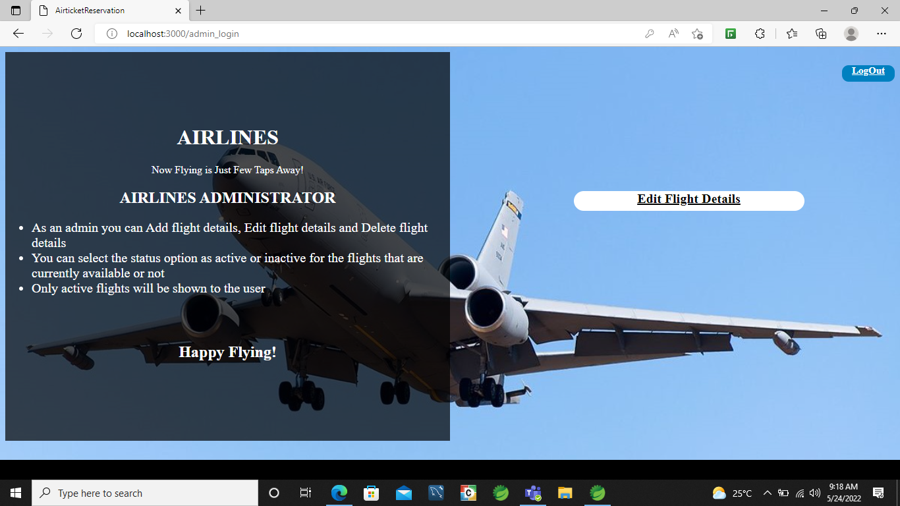
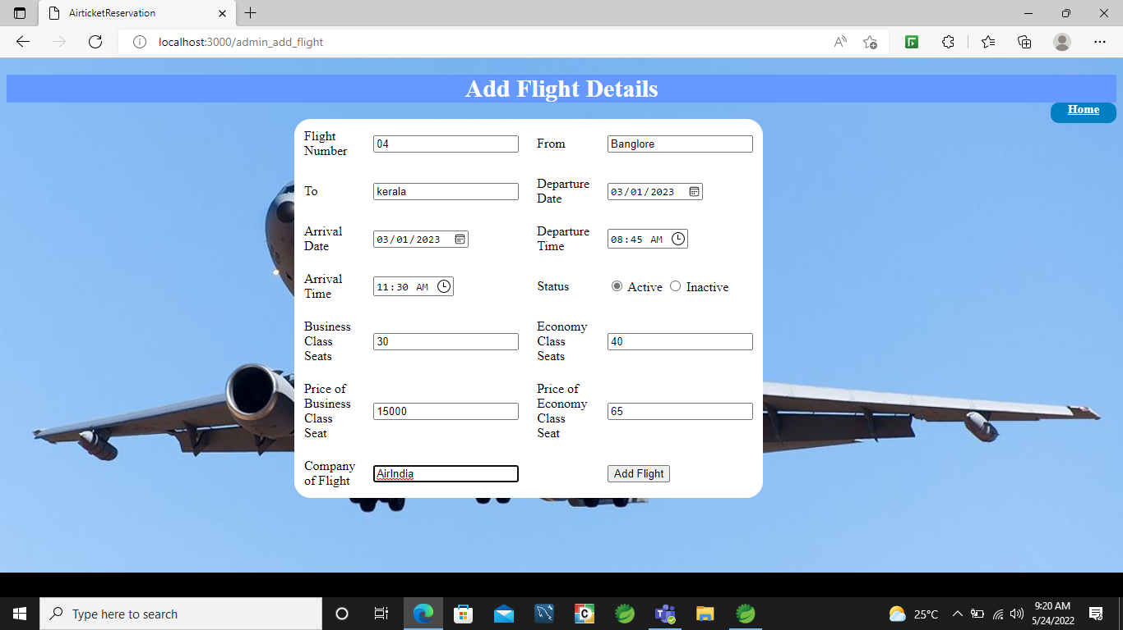
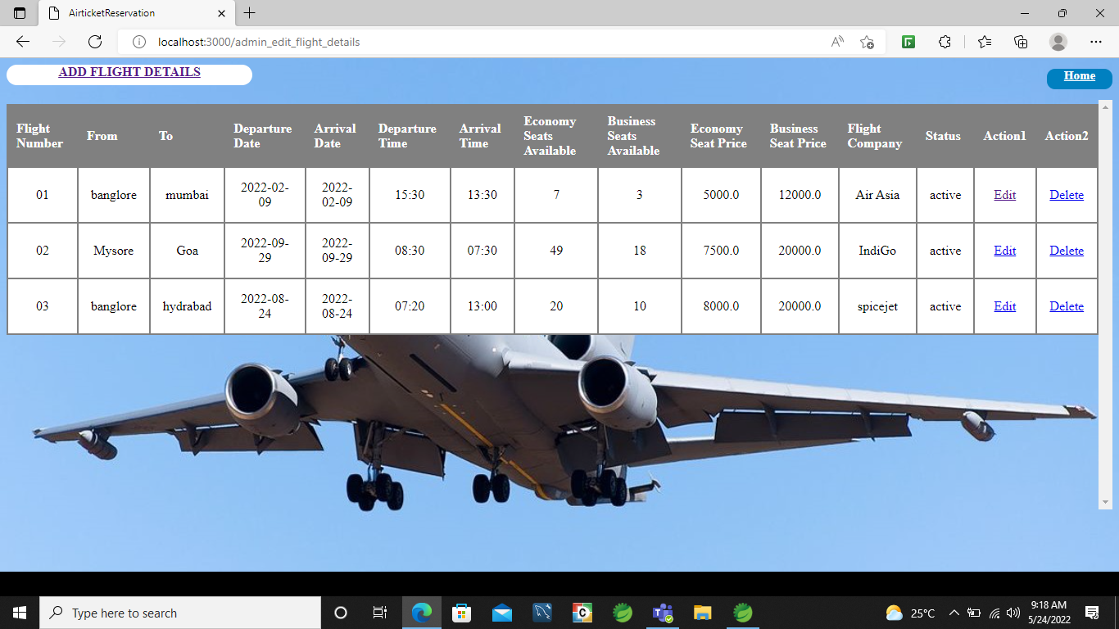
ADMIN PAGE

Slide 11
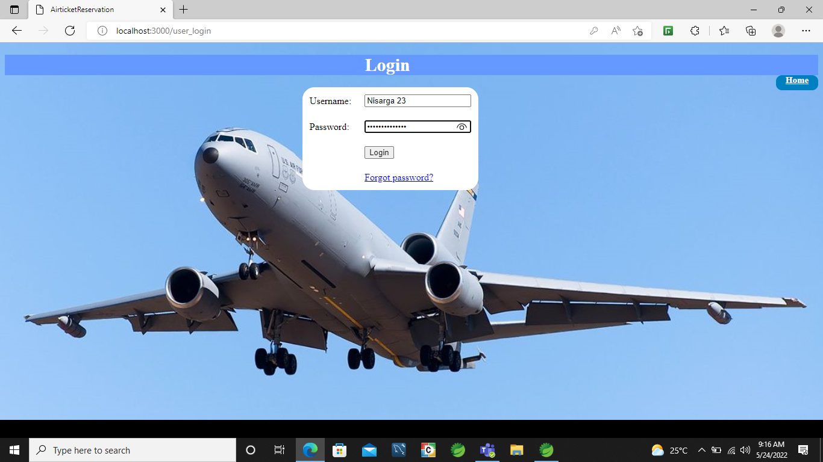
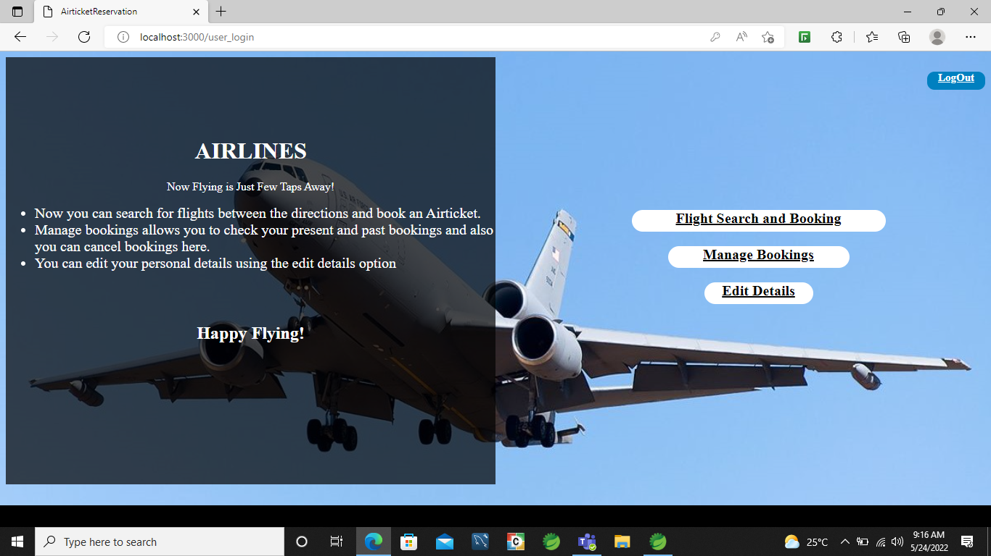
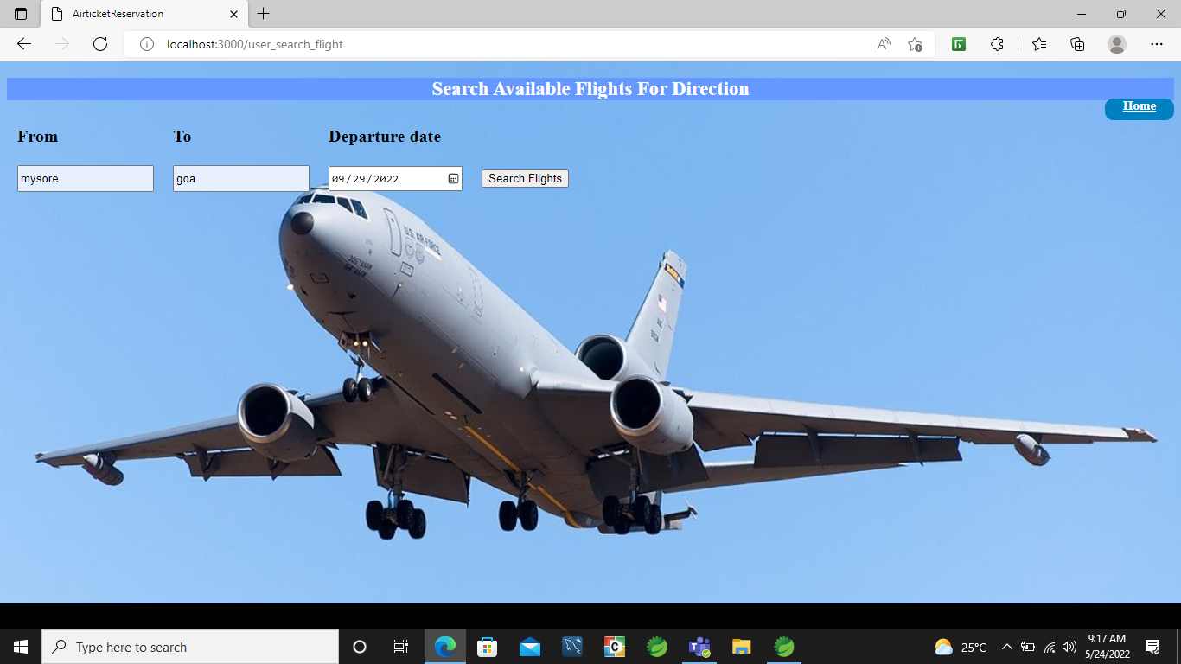
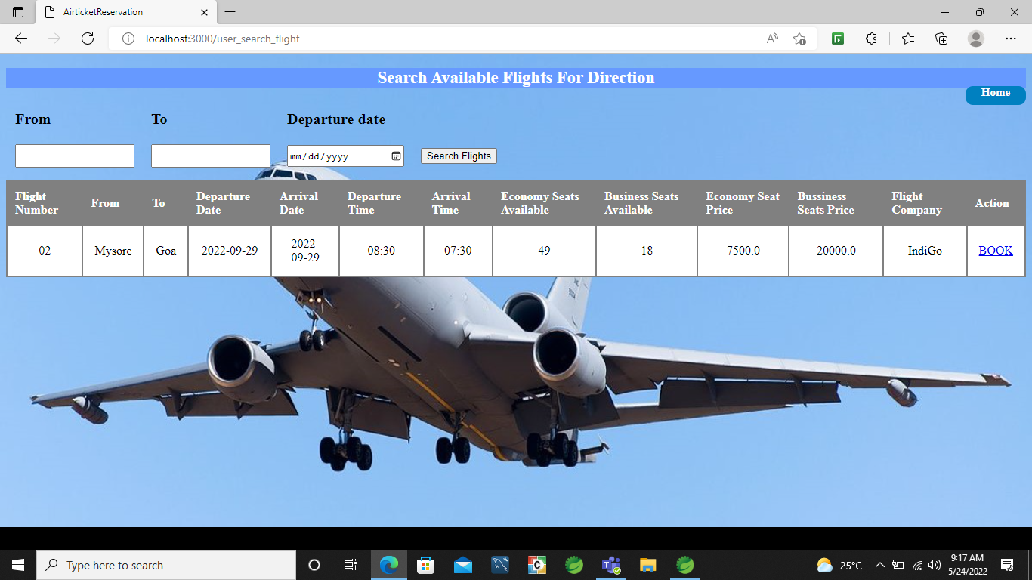
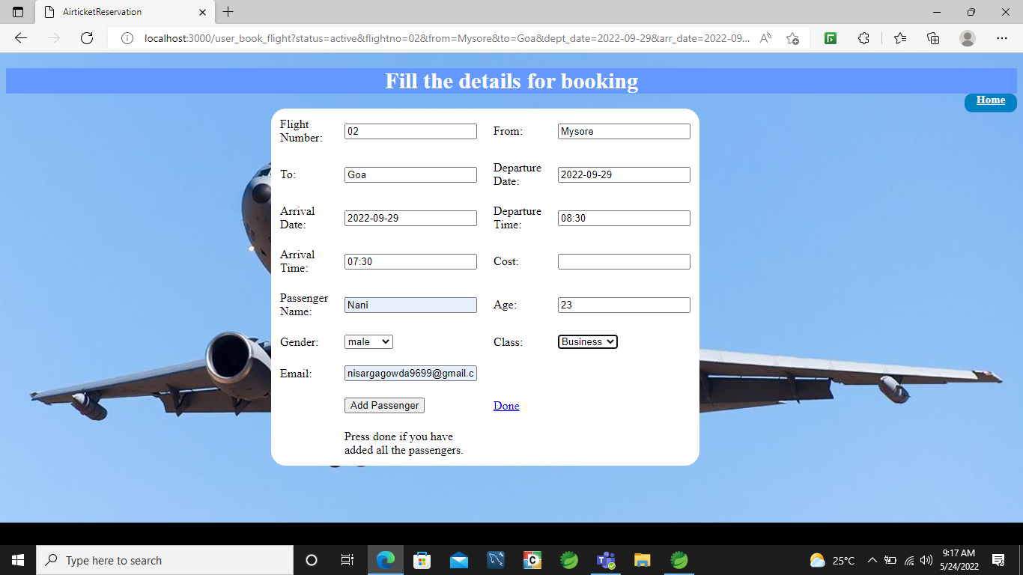
USER PAGE

Slide 12
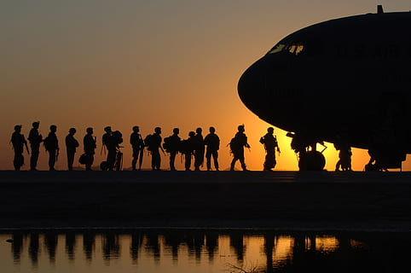
THANK YOU

